Slide 1
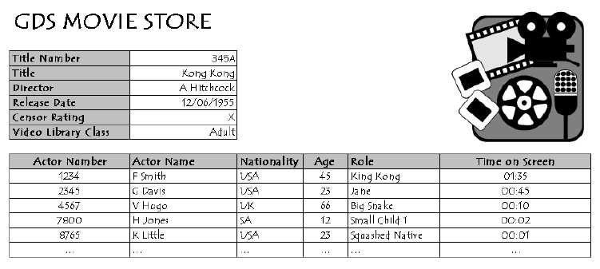
Conversion to Third Normal Form (3NF) - Tutorial 5
Question
Convert the GDS Movie Store data provided below to the 3rd Normal Form (3NF) and name the entities
Define the rules which should be followed to convert raw data to 3NF.

